Slide 2


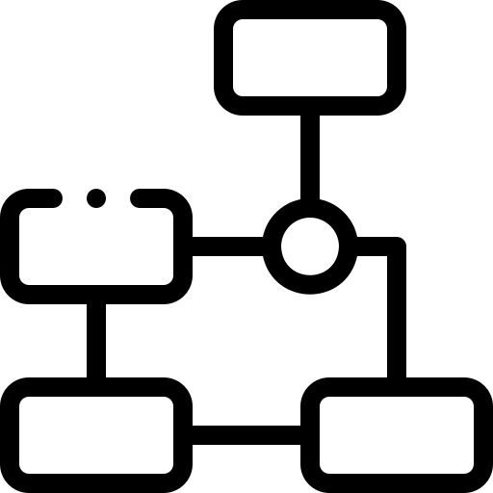
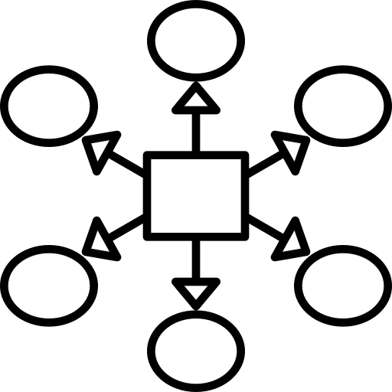



Slide 3
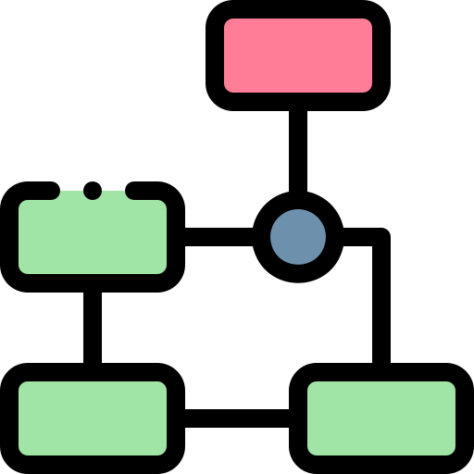


UML
Definition
About me I will share with you all about works I delivered
UseCase Diagram
UML
Use case
Sequence
Scenario
Activity
Class
Activity Diagram
Definition:
The Unified Modeling Language (UML) is a general-purpose modeling language in the field of software engineerin which is designed to provide a standard way to visualize the design of a system.
We are the main titles project icons that represents what our project used programs
We are the
Subtitles
Like this way you can reach any slide you want
My apologies for interrupting you sir, however I still have an option that I would like to present to you

Slide 4
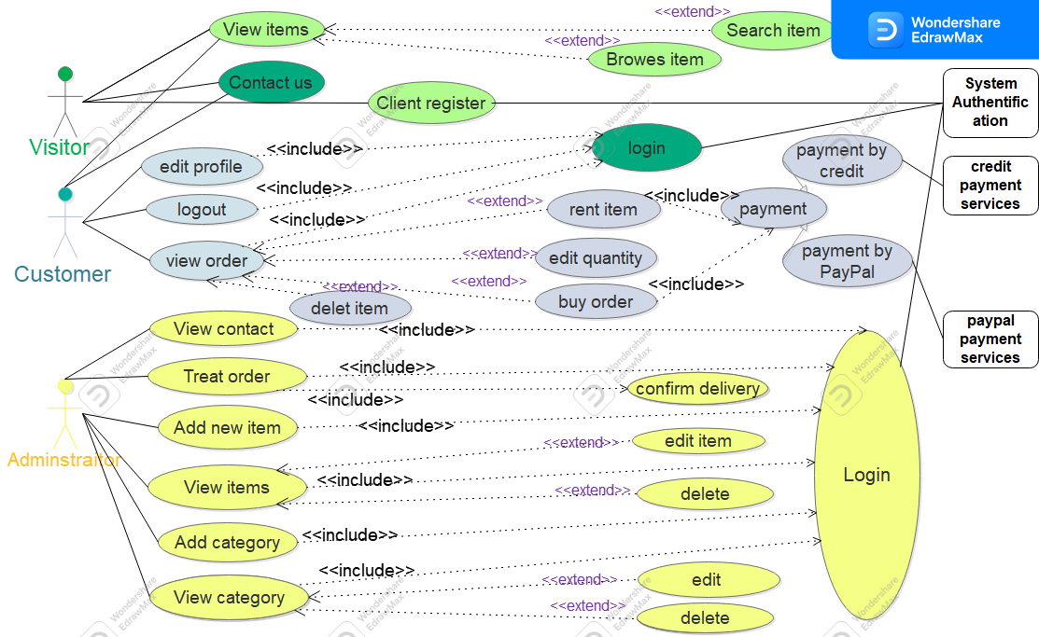
UML
Definition
UseCase diagram
Activity Diagram
UseCase Diagram:
is in uml alogorithim that represent what the actor can do

Slide 5
ClickUp
Activity diagram
UseCase Diagram
UseCase Diagram
ClickUp:
ClickUp is our project management system me and my team classified everyone should do with ClickUp
Please tab on ClickUp button get idea what we mean

Slide 6
ClickUp
Activity diagram
UseCase Diagram
UseCase Diagram

Slide 7
FIGMA

